Slide 1
EEL 6764 Principles of Computer Architecture
Instructor: Srinivas Katkoori
Department of Computer Science & Engineering
University of South Florida Tampa, FL 33620 Email: katkoori@usf.edu
Acknowledgement
Slides adapted from Prof. Zheng’s Fall 2022 slides

Slide 2
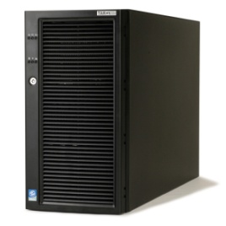

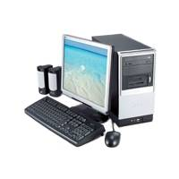

Ubiquitous Usage of Computers
Embedded applications
General purpose computing
~2%
~98%
Today’s high-end computers have
Tens of Billions of transistors in a chip
Tera-flops (10^12 FPOS) processing power
Notes:
Why is it important – computers are everywhere, with diverse characteristics and requirements!
Wrong arch design --> failed products and loss of markets!
explain general-purpose computers and special purpose natures of embedded computers.

Slide 3
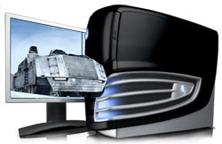
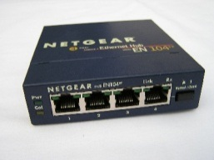

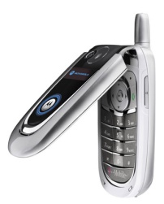
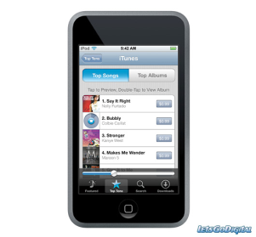
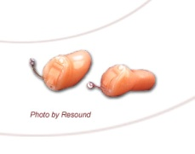
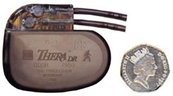
Computer Applications
General purpose computing: internet server, database server, real-time jobs etc.
Ultralow power applications: medical, space, specific sensor network etc.
POWER
Portable applications: mobile computing, wireless, multimedia etc.
PERFORMANCE
Different applications have different power-performance demands
Notes:
EE695KR -- Adv. VLSI Design
K. Roy
3

Slide 4
How Do the Pieces Fit Together?
Algorithms, programming
Application
Operating
Operating system
System
Compiler
Firmware
Compilers
Instruction Set
Architecture
Memory
system
Instr. Set Proc.
I/O system
This course
Datapath & Control
CSD
Digital Design
Logic design
Circuit Design
CMOS VLSI, low-power
Coordination of many levels of abstraction
Under a rapidly changing set of forces
Design, measurement, and evaluation
Notes:
A computing system is very complex, and its functioning under certain metrics requires coordination of efforts at different abstraction levels.

Slide 5
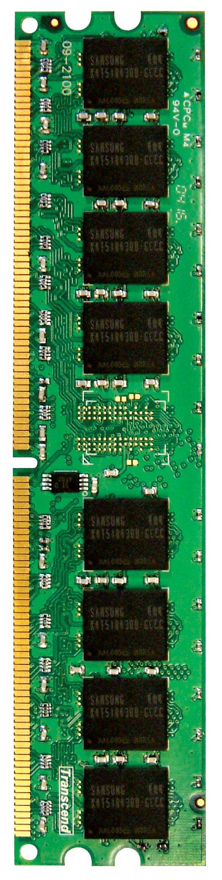
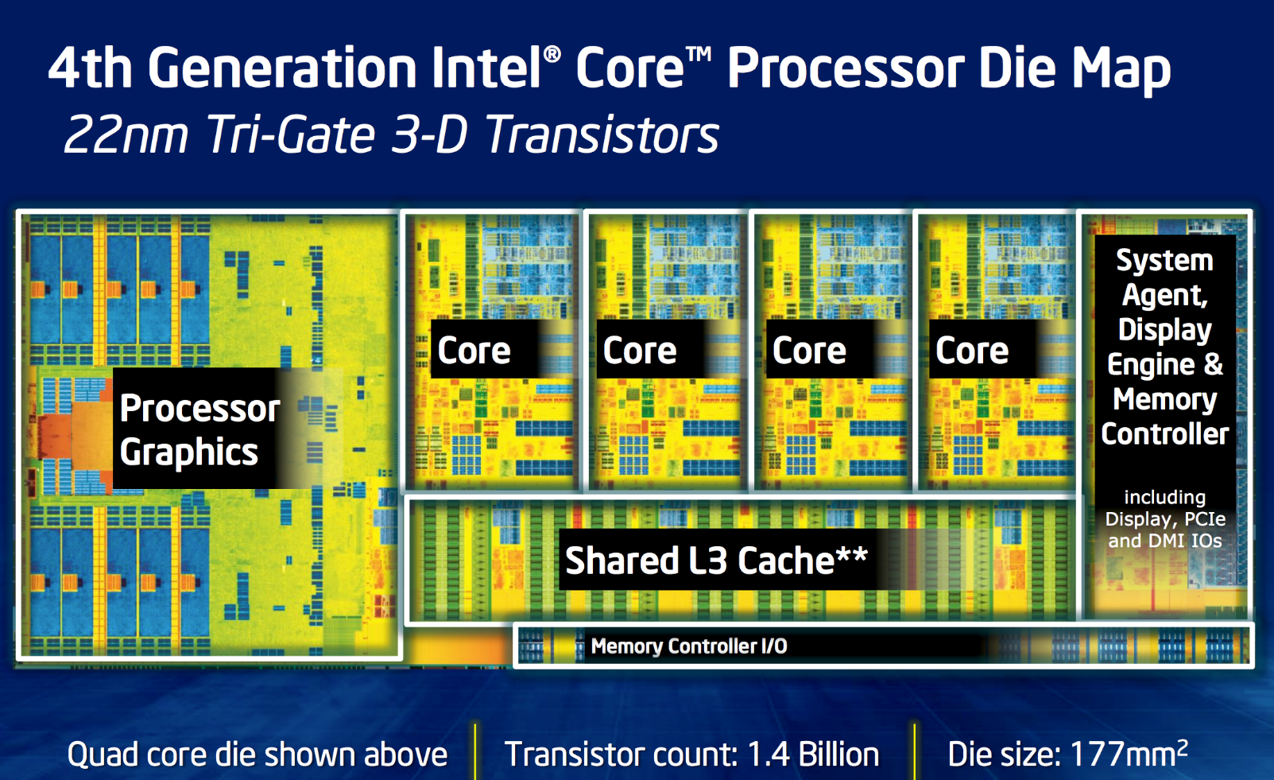
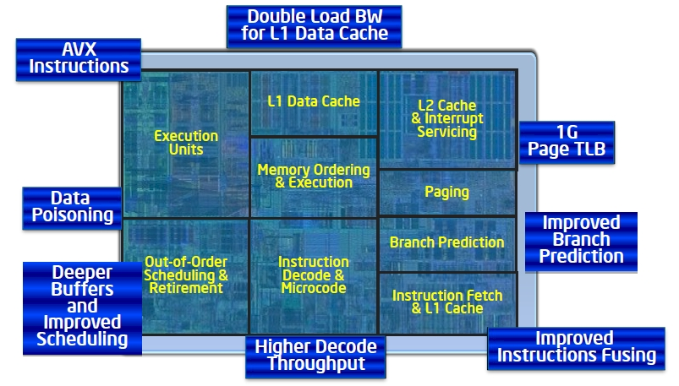
A Processor Example
DRAM BANKS
The objective of this course is to study most of these components

Slide 6
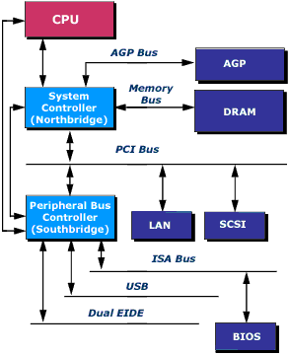
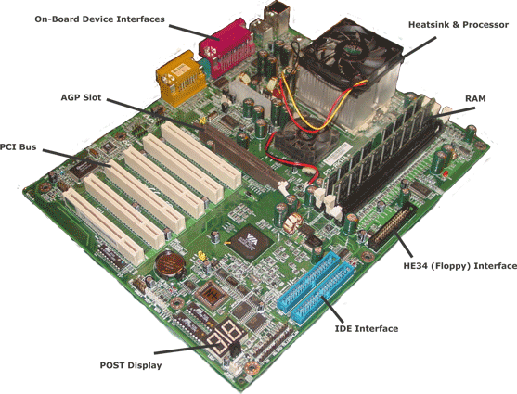
A System-Level View
Processor
Graphics
Memory
IO Bus
Processor Interface
Disk/USB Interface
Notes:
Processor is only one component of an entire system, which includes other components like memory, storage, buses, etc
Processor chip is hidden under the heat sink
DRAM memories are on DIMMS (dual in-line memory modules)

Slide 7
What is Computer Architecture?
“Computer architecture is the science and art of selecting and interconnecting hardware components to create a computer that meets functional, performance, and cost goals.” *
* G. Sohi, UW
Think about architecture of buildings!
Notes:
Does not concern the detailed implementations of those components.

Slide 8
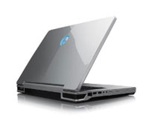
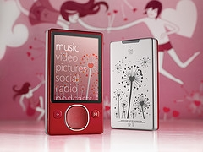
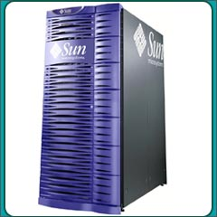
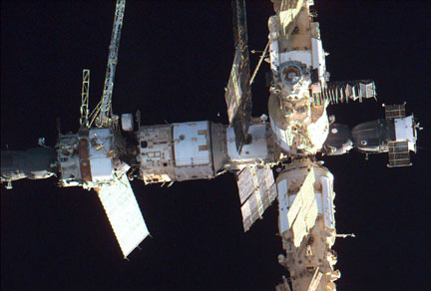
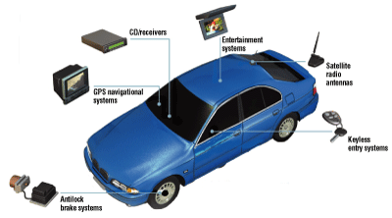
System Design Parameters
Performance (Speed)
Cost
Power (static + dynamic)
Peak power
Average power
Robustness
Noise-tolerance
Radiation-hardness
Testability
Reconfigurability
Time-to-market etc.
Notes:
EE695KR -- Adv. VLSI Design
K. Roy
8
Security is gaining tractions recently.
this course focuses more on performance, but will touch power/energy

Slide 9
Classes of Computers
Shipments: 1.9B PMD, 350M Desktop, 19B Embedded.
Desktop has largest $ market share.
1.2 Classes of Computers
Notes:
Cluster/WSC = many servers connected by LAN acting as one.
Supercomputer = a kind of WSC with a focus on float point perf.
Embedded vs PMD : PMD can run external SW while embedded cannot.

Slide 10
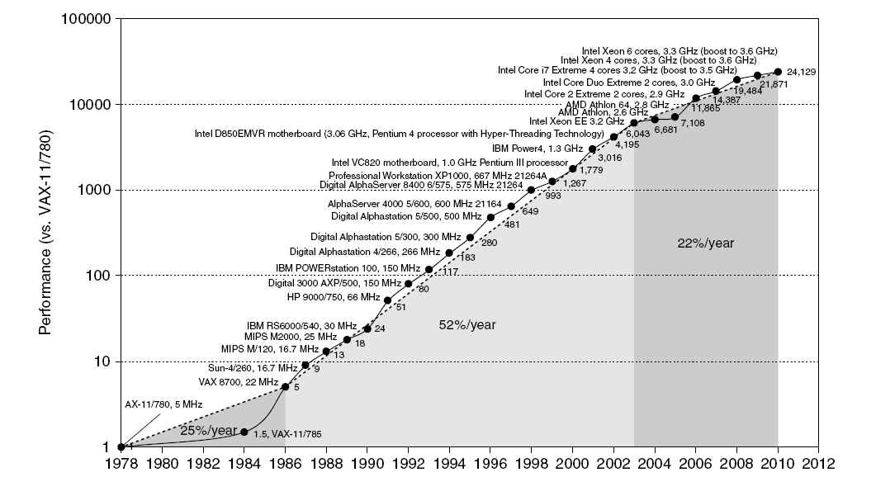
Single Processor Performance
Move to multi-processor
RISC
1.1 Introduction
Notes:
The great improvements are the results of advances in
implementation technologies + computer architecture.

Slide 11
Computer Technology Driving Forces
Improvements in semiconductor technology
Feature size, clock speed, cost
Improvements in computer architectures
Enabled by high-level language compilers, UNIX
Led to RISC architectures
Together have enabled:
More powerful and efficient computers.
New classes of computers, i.e. mobile devices, etc.
Penetration of GP CPUs into many applications.
Tradeoff between performance and productivity in SW development.
1.1 Introduction

Slide 12
Current Trends in Architecture
Hurdles
Power Wall – limits on power consumption
Memory Wall – limits on memory access speed
Lack of Instruction-Level parallelism (ILP) to exploit
Single processor performance improvement ended in 2003
New opportunities for improving performance:
Data-level parallelism (DLP)
Thread-level parallelism (TLP)
Request-level parallelism (RLP)
These require explicit restructuring of the applications
Applications must expose parallelism explicitly.
1.1 Introduction
Notes:
transition from single-core → multicore: power/memory walls
Exploiting ILP cannot continue without enormous power consumption overhead.

Slide 13
Classes of Parallelism
Exploitation of parallelism --> performance
Classes of parallelism in applications:
Data-Level Parallelism (DLP)
Task-Level Parallelism (TLP)
Classes of architectural parallelism:
Instruction-Level Parallelism (ILP)
Vector architectures/Graphic Processor Units (GPUs)
Thread-Level Parallelism (TLP)
Request-Level Parallelism (RLP)
1.2 Classes of Computers
Notes:
architectural parallelism – types of parallelism extracted from programs and exploited by architecture

Slide 14
Flynn’s Taxonomy
Single instruction stream, single data stream (SISD)
Exploit ILP and TLP in some degree
Single instruction stream, multiple data streams (SIMD)
Targets DLP
Vector architectures
Multimedia extensions
Graphics processor units
Multiple instruction streams, single data stream (MISD)
No commercial implementation
Multiple instruction streams, multiple data streams (MIMD)
Targets TLP and RLP
Tightly-coupled MIMD - TLP
Loosely-coupled MIMD - RLP
SD
MD
SI
SISD | SIMD
X | MIMD
MI
1.2 Classes of Computers

Slide 15
Technology Trends

Slide 16
Technology Trends
Integrated circuit technology
Transistor density: +35%/year
Die size: +10-20%/year
Integration overall: +40-55%/year
DRAM capacity: +25-40%/year (slowing)
Foundation of main memory.
Flash capacity: +50-60%/year
8-10X cheaper/bit than DRAM
An order of magnitude slower than DRAM
Magnetic disk technology: + ~50%/yr
15-25X cheaper/bit than Flash
300-500X cheaper/bit than DRAM
Main storage for server or WSC.
Important to design for the next generation of technology!
Current technologies approaching their limits; new technologies being researched
1.4 Trends in Technology
Notes:
Architecture needs to account for technology trends for long term viability
CPU: integration (Moore’s law) slowing down, transistor performance limited by power constraints
DRAM: capacity increases at slower pace
Magnetic disks: density increases at slow pace

Slide 17
First Microprocessor
1.4 Trends in Technology
Notes:
Section 1.4

Slide 18
Height of Single-Core Processor
1.4 Trends in Technology
Notes:
Section 1.4
Most increase in transistors on-chip are used to implement modern features such as cache, speculation, to improve performanc

Slide 19
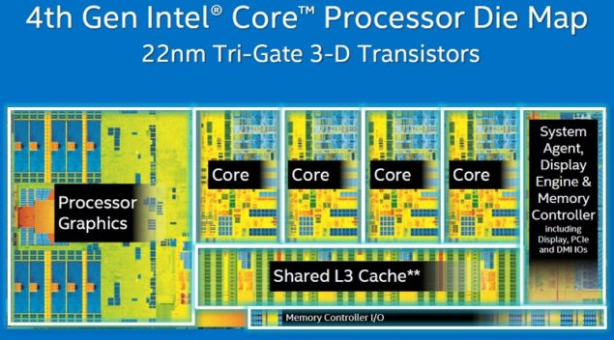
MultiCore Processor
1.6 billion transistors, released in 2013.
1.4 Trends in Technology
Notes:
Section 1.4
Most increase in transistors on-chip are used to implement modern features such as cache, speculation, to improve performanc

Slide 20
Transistors and Wires
Transistor feature size
Minimum size of transistor or wire in x or y dimension
10 microns in 1971 to .032 microns in 2011
Now in 2020/2023, seeing 7nm – 3nm.
Transistor density grows exponentially.
Moore’s law – has been slowing down
Transistor performance scales linearly
Wire delay does not improve with feature size!
In fact, it is getting worse!
Make on-chip interconnect design an important task!
1.4 Trends in Technology
Notes:
transistor performance scaling is slowing down to linearly
Wire delay ~ wire length & !~ wire size
wire latency improves slower than transistors → interconnect design is increasingly more important
The performance gap between transistors and wires makes moving data very expensive.

Slide 21
Performance Measures
Bandwidth or throughput
Total work done in a given time
Important for servers and data center operators
Latency or response time
Time between start and completion of an event
Important for individual users
1.4 Trends in Technology
Notes:
Transportation as another example
Planners concern with throughput of the roads
Individual drives concern with the time going from one point to another

Slide 22
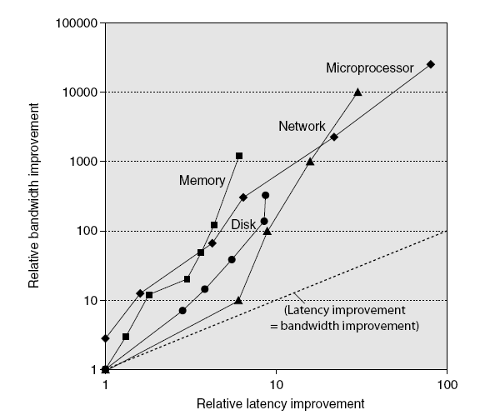
Bandwidth and Latency
Bandwidth
10,000-25,000X improvement for processors
300-1200X improvement for memory and disks
Latency
30-80X improvement for processors
6-8X improvement for memory and disks
Improvement in Bandwidth = square of improvement in latency
Log-log plot of bandwidth and latency milestones
1.4 Trends in Technology
Notes:
BW and latency are related: increasing BW could reduce latency, or vice versa

Slide 23
Power and Energy
Problem: Get power in, distribute it, get it out
Maximal power consumption
Thermal Design Power (TDP)
Characterizes sustained power consumption
Used as target for power supply and cooling system
Lower than peak power, higher than average power consumption
System energy efficiency
Often a better measurement of overall system efficiency
Power = a design constraint
1.5 Trends in Power and Energy
Notes:
in computer, energy refers to electricity
electricity is consumed to make operations to happen, and becomes heat
Heat dissipation is the major block from increasing frequency.
TDP is the power designed such that the generated heat can be dissipated without causing slowdown or damage of chips

Slide 24
Dynamic Energy and Power
Dynamic energy
Transistor switch from 0 -> 1 or 1 -> 0
Dynamic power
Relation between energy and power consumption
P: power, E: energy, f: switching frequency
Reducing clock frequency reduces power, not energy
1.5 Trends in Power and Energy
Notes:
C: switching (active) capacitance
At the same P, smaller E → higher f: more efficient design can run faster without consuming more power!

Slide 25
Power and Energy – Example
Suppose two designs have the same clock frequency.
Design 1 consumes, on average, 20% less energy per operation than Design 2.
Design 1’s power is 20% less than design 2 if they run at the same speed
Design 1 dissipates less heat with the same performance of design 2
Or, design 1’s clock frequency can be improved by 25% while consuming the same power as design 2.
1.5 Trends in Power and Energy
Notes:
Heat dissipation is the major block from increasing frequency.
Energy efficiency helps increase performance.

Slide 26
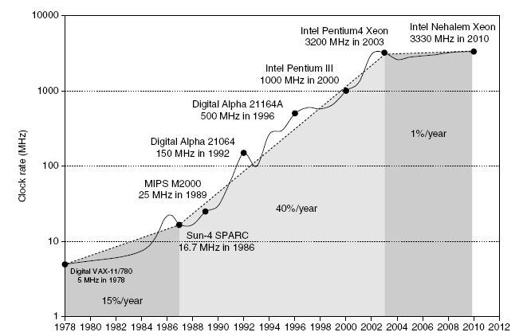
Power & Clock Frequency
Intel 80386 consumed ~2 W
3.3 GHz Intel Core i7 consumes 130 W
Heat must be dissipated from 1.5 x 1.5 cm chip
This is the limit of what can be cooled by air.
Performance improvement by increasing f is over!
1.5 Trends in Power and Energy

Slide 27
Reducing Power
Techniques for reducing power:
Reduce clock frequency
Turn off components not being used – dark silicon
Dynamic Voltage-Frequency Scaling
Low power state for DRAM, disks
Overclocking, turning off all but one core
Energy efficiency has become a critical quality metric
Measured by tasks/joule or performance/watt
1.5 Trends in Power and Energy

Slide 28
Static Power
Transistors are not perfect switches
leakage current even when no switching
Static power consumption
Current_{static} x Voltage
Scales with number of transistors
To reduce: power gating
Leakage Power Trends (2008)
1.5 Trends in Power and Energy
Notes:
Static power -- Increasing share of overall system power.

Slide 29
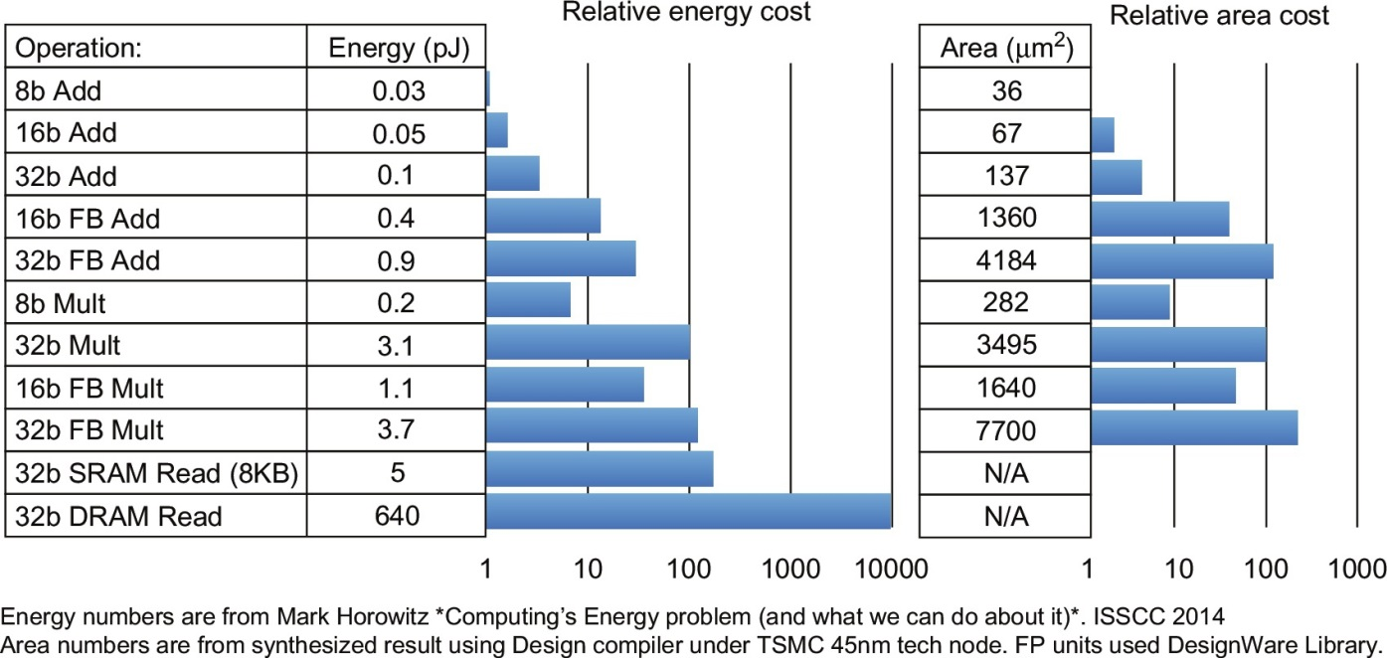
Where are Energy/Area Consumed?

Slide 30
Factors Affecting Cost
Cost: design, manufacturing, testing, material, etc.
Design – one time cost
Manufacturing ... – recurring cost
Cost driven down by learning curve
Yield: ratio between good products among all.
Increase in volume --> reduced unit cost
10% less for each doubling of volume
Design cost amortized over volume
Material cost lower on large volume
Operating cost: significant for data center
1.6 Trends in Cost
Notes:
Cost = design + testing + material + production
------ --------------------------------
OTC recurring cost

Slide 31
Integrated Circuit: Wafer and Die
die
wafer
1.6 Trends in Cost

Slide 32
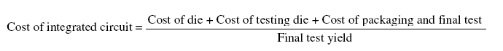
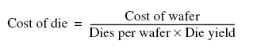
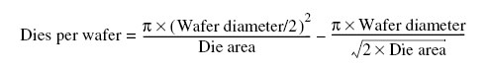
Cost of Integrated Circuit Cost
Cost of Integrated circuit
Bose-Einstein formula:
Defects per unit area = 0.016-0.057 defects per square cm (2010)
N = process-complexity factor = 11.5-15.5 (40 nm, 2010)
1.6 Trends in Cost
Notes:
Yield improves by following the learning curves.
Summary – cost proportionally to die area

Slide 33
Principles of Computer Design

Slide 34
Measuring Performance
Typical performance metrics:
Response (execution) time & throughput
Speedup of X relative to Y
Execution time_{Y} / Execution time_{X}
Execution time
Wall clock time: includes all system overheads
CPU time: only computation time
Benchmarks
Kernels (e.g. matrix multiply)
Toy programs (e.g. sorting)
Synthetic benchmarks (e.g. Dhrystone)
Benchmark suites (e.g. SPEC06fp, TPC-C)
Can be mis-leading
1.8 Measuring Performance
Notes:
CPU time: measure the efficiency of processors.
Wall clock time: measure overall system efficiency.

Slide 35
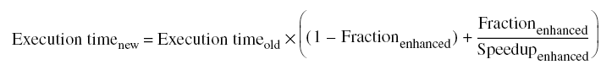
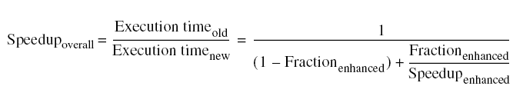
Principles of Computer Design
Take Advantage of Parallelism
e.g. multiple processors, disks, memory banks, pipelining, multiple functional units
Principle of Locality
A property of programs: data and instructions typical reused
Focus on the Common Case – Amdahl’s Law
1.9 Quantitative Principles of Computer Design
Notes:
Locality: foundation of cache concept, critical for HW prediction
Temporal and spatial locality
Focus on common case: 90% time spent in 10% of the code, then optimize that 10% of the code.

Slide 36
Amdahl’s Law - Example
Suppose a new processor is 10 times faster in computation than the current one. Assume that the current processor is 40% time busy with computation and 60% of the time idle waiting for IO. What is the overall speedup with the new processor?
1.9 Quantitative Principles of Computer Design
Notes:
Amdahl’s law can be applied to cases other than performance

Slide 37
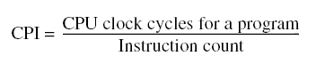
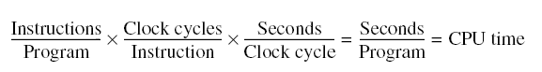
The Processor Performance Equation
ISA
compiler
arch
technology
arch
1.9 Quantitative Principles of Computer Design
Notes:
CPI here – average CPI

Slide 38
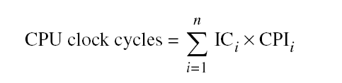
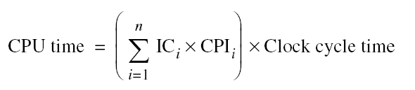
The Processor Performance Equation
Different instruction types having different CPIs
IC_{i} : count of instruction i in a program.
CPI_{i} : average cycle count for instruction i
1.9 Quantitative Principles of Computer Design
Notes:
Considering CPI for different instructions leads to more precise CPU time calculation

Slide 39
Suppose the following measurements
fraction of FP ops = 25%
Average CPI of FP ops = 4 cycles
fraction of FPSQR = 2%
Average CPI of FPSQR = 20 cycles
Average CPI of other inst = 1 cycles
Design #1: decrease CPI of FPSQR to 2
Design #2: decrease CPI of FP ops to 2
Compare these two design alternatives.
1.9 Quantitative Principles of Computer Design

Slide 40
Summary
Computer architecture involves ISA, microarchitecture, HW technologies.
Is about making tradeoffs among design parameters optimized for target applications.
Should be mindful about technology trends, and their impacts on comp. design.
Classification of comp. arch. wrt different types of parallelism they exploit.
Reviews of trends of various system parameters.
Overviews of computer design principles
Exploitation of parallelism, locality, optimization for common cases, etc.
Processor execution time evaluation

Slide 41
Backup

Slide 42
Where is the Market?
It is estimated that there will be between 15 and 20 billion devices (small embedded devices) with a $900 Billion USD market, which is growing twice as fast as the PC market.
Millions of Computers
Embedded applications: mobile electronics, automobile electronics, home electronics, communications and networking, healthcare products, sensor networks, gaming hardware, defense applications and many others!

Slide 43
Computer Architecture – Past and Now
Computer architecture – Past
Instruction Set Architecture (ISA) design
i.e. decisions regarding:
registers, memory addressing, addressing modes, instruction operands, available operations, control flow instructions, instruction encoding
Computer architecture – Now
ISA design is less of a focus
Meet specific requirements of the target machine
Design to find a best tradeoff among performance, cost, power, and availability, etc, optimized for target applications
Consider ISA, microarchitecture, logic/circuit design, implementation, etc.
Impacts from requirements of applications and technology.
1.3 Defining Computer Architecture
Notes:
Modern computer arch design is much broader:
Design requirements that stem from the target applications a new computer tries to solve.

Slide 44
Dependability
As feature size shrinks, computers fail more often.
Module reliability
Mean time to failure (MTTF)
Mean time to repair (MTTR)
Mean time between failures (MTBF) = MTTF + MTTR
Availability = MTTF / MTBF
= a ratio between service time and total life span
To improve reliability: redundancy.
1.7 Dependability
Notes:
Analogy: a car w or w/o a spare tire.

